Slide 1



My Journey: From Resilience to Growth
Urbanus Wambua's story of resilience and aspirations.
Notes:
1

Slide 2


Beginnings: A Humble Start
Grew up in Makueni, Kenya.
Early Education
1
Attended Kitende Primary and Nursery (2004-2014).
Rural Schooling
2
Experienced challenges of rural education.
Notes:
3

Slide 3

Challenges in Access to Education
Struggled to afford school fees.
1
Resourcefulness
Borrowed books and materials.
2
Scholarships
Won the Wings to Fly Scholarship, a pivotal moment in my education.
The lack of resources was a significant obstacle, but it instilled in me the value of resourcefulness and persistence. My determination to secure scholarships and financial assistance became my lifeline to education.
3
Notes:
4

Slide 4
High School Struggles & Triumphs
Attended Mumbuni Boys High School (2015-2018) through the Wings to Fly program.
Challenges
Triumphs
Experienced bullying and socioeconomic pressure.
Developed courage and stood up for peers.
Notes:
5

Slide 5





University Life and Hard Work
Balanced studies with part-time work.
Currently
Currently pursuing a BSc in Computer Science at Dedan Kimathi University of Technology.
Academic_leave
Balanced part-time work with studies to support my education and family .Took an academic leave for 2 years so as to work and get finances to finance my education.
Time Management
Developed strong time management skills, discipline, and resilience through these experiences.
Working while studying was a necessity, but it became a source of strength. I learned how to prioritize my time effectively while staying focused on my long-term goals.
Notes:
6

Slide 6
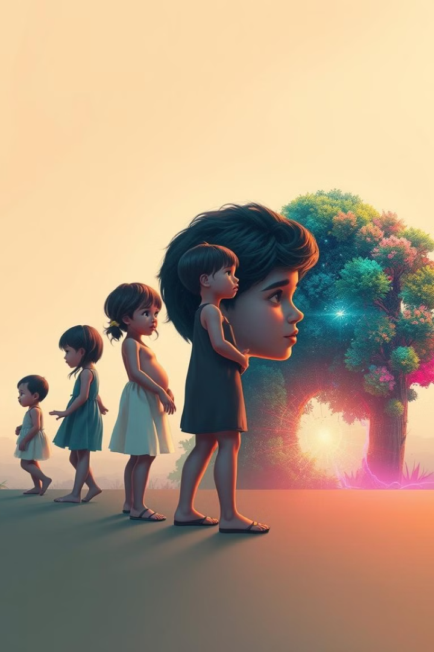
Defining Moments of Growth
Financial hardship to academic success.
Challenges
Growth
Limited technology access
Overcame limitations.
Financial hardship required resilience and persistence.
Each challenge I faced, whether it was financial constraints or navigating institutional barriers, shaped me into the person I am today. These experiences taught me how to adapt, persevere, and grow.
Navigated institutional bureaucracy, learning the importance of patience and effective communication.
Notes:
7

Slide 7
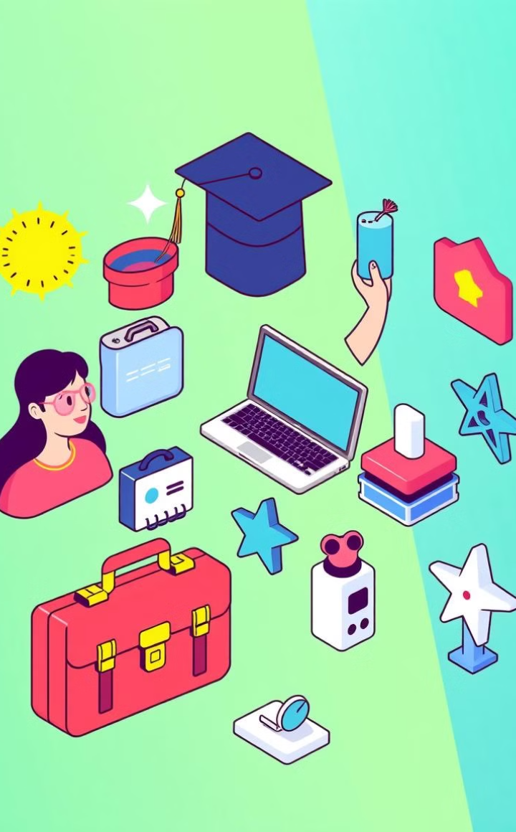




Aspirations for the Future
Graduation, internship, career, and entrepreneurship.
Graduation
Achieve a BSc in Computer Science.
Internship
Aspiring to intern at a leading tech company.
Career
Secure a job and pursue advanced education.
Entrepreneurship
Start a technology venture.
GiveBack
Committed to giving back to the community through mentorship and tech initiatives.
Goal
"My goals are centered around both personal success and community impact. I aspire to use my skills and experiences to make a positive difference in the world, particularly in technology and education."
Notes:
8

Slide 8

Reflection & Looking Forward
Grateful for lessons learned through adversity.
Commitment
1
Committed to personal growth and contributing to the community.
Optimism
2
Optimistic about the future and excited to continue learning.
Notes:
9

Slide 9

Thank You
Thank you for your time. My journey continues.
Notes:
10

